Slide 2
Unit 6: Discrete System Languages (6 hrs)
6.1 Simulation using GPSS
6.1.1 GPSS problems
6.2 Simulation using SIMSCRIPT
6.2.1 Organization of SIMSCRIPT
6.2.2 Programs of SIMSCRIPT
6.3 Other Discrete Simulation Languages

Slide 3
Simulation Language
Simulation languages are versatile and serve a general purpose, enabling various modeling operations through different classes of simulation software.
These languages are similar to FORTRAN, C#, VB.NET, and Java, while also incorporating specific features to enhance the modeling process.
Some examples of modern simulation languages are GPSS/H, GPSS/PC, SLX and SIMSCRIPT III.
Simulation language exists for discrete, continuous, and agent-based modelling paradigms.

Slide 4
Features of Simulation Language
Most simulation languages should have the following features:
Simulation clock or a mechanism for advancing simulated time.
Methods to schedule the accuracy of the event.
Tools to collect and analyze statistics concerning the use of various resources and entities.
Tools for reporting the result.
Debugging and error detection facilities.
Random number generator and related set of tools.
The General framework for model creation.

Slide 5
Working on Simulation Language
Most discrete event simulation languages model a system by updating the simulation clock to the time that the next event is scheduled to occur.
Events and their scheduled times of occurrence are maintained automatically on one of two order lists,
current event chain: this keeps a list of all events that will occur at the present clock time.
future event chain: this is a record of all events that can occur at some point in the future.

Slide 6
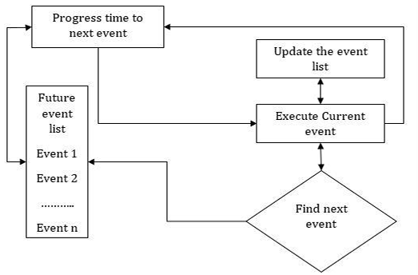
Working on Simulation Language
A simulation clock moves to the next event on the future events chain and changes the system state of the model based on the characteristics of that event.

Slide 7
Merits of Simulation Language
Since most of the features to be programmed are built-in, simulation language takes comparatively less programming time and effort.
Since simulation language consists of blocks, specially constructed to simulate the common feature, they provide a natural framework for simulation and modelling.
Simulation models coded in a simulation language can be easily changed and modified.
The error detection and analysis are done automatically in a simulation language.
Simulation models developed in simulation language, especially the specific application package called simulators, are very easy to use.

Slide 8
Features of Simulation Software
Modelling Flexibility: The simulation must be flexible enough to adapt to changes in the configuration. The domain of application should be wide, and the model should be equally valid over the whole domain.
Ease of Modelling: It should be easy to develop the simulation model, easy to debug the program, and validate the model. The software should have an in-built interactive debugger, error detector, and online health.
Fast Execution Speed: The speed of execution is always a very important requirement of any simulation model. It is especially an essential feature in the case of the simulation of a large and complex system.

Slide 9
Features of Simulation Software
Compatibility with Various Computer Systems: The simulation language should be compatible with various computer systems like microcomputers, engineering workstation minicomputers, and mainframe computers.
Statistical Capabilities: A simulation software should contain multiple stream random number generators and as many standard probability distributions as possible. It should have blocks for designing the statistics like the simulation run, warming up period, and the number and the length of replication.

Slide 10
Features of Simulation Software
The Capability of Animation: The animation capability of the simulation package is one of the main reasons for the popularity of the simulation language. The animation is carried out in two modes, i.e., concurrent mode and playback mode.
Report Presentation Capabilities: The output of the simulation, the model should be well documented and illustrated. The user should be able to get the information of their interest in an easily understandable form.

Slide 11
Types of Simulation Languages
A variety of simulation languages exist and are used by business, researchers, manufacturing and service companies, and consultants.
Continuous system simulation language (CSSLS)
Discrete system simulation language (DSSLS)
Hybrid system simulation language (HSL)

Slide 12
Continuous System Simulation Language
Before digital computers come into common use, analog computers were being used for simulating continuous system.
The system in an analog computer was represented by the block of electronic devices such as operational amplifier to carry out the required operation.
As soon as the digital computer came, it provides many advantages over analog computer like greater accuracy, freedom for scaling, easily stored for reuse etc.
Therefore, a special program package were implemented on digital computer to make a digital computer appear like analog computer.
This is called a digital analog simulators.
Example: DEPI, DEPI-4, DAS, MIDAS, IBM 1130, CSSL, CSMP, etc.

Slide 13
Continuous System Simulation Language
Types:
Block Structured Continuous Simulation Language
These are designed to simulate only those system that could be represented as analog block diagrams and thus their application are limited.
It requires user to prepare an analog computer type block diagram and then input this diagram.

Slide 14
Continuous System Simulation Language
Types:
Expression Based Language
A block-oriented language is limited because of its small specialized vocabulary.
Since, the system must be represented first in analog block diagram, so this language are suited only for analog system and not the system as set of equations.
Expresssion based language or statement-based language overcome this drawback.
Expression based language do not follow block structure diagram but directly implements the differential equation of the model.

Slide 15
Discrete System Simulation Language
These languages are used to simulate discrete system and provide the following facilities.
Automatic generation of random number
Automatic data collection
Statistical analyses of data
Reporter generators, etc.

Slide 16
Discrete System Simulation Language
Types:
Event oriented language
In an event-oriented language each event is represented by an instantaneous occurrence in simulated time and must be scheduled to occur in advance when a proper set of conditions exists.
The system image changes i.e., state of system changes at the occurrence of event.
Example, SIMSCRIPT, GASP

Slide 17
Discrete System Simulation Language
Types:
Activity oriented language
In an activity-oriented language, the discrete occurrences are not scheduled in advance.
They are created by a program which contains description of the conditions under which an activity can take place.
The activity-oriented language have two components: Test component and action component. Here the event occurrence must be controlled by a cyclic scanning activity program.
Example, MILITRAN

Slide 18
Discrete System Simulation Language
Types:
Process oriented languages
Here a single process routine, composed of number of segments describe a sequence of activities.
Each segment has an independently controlled program.
On receiving control, only the statement composing the segments are executed, and then control is returned.
Example, ASPOL, SIMUFOR

Slide 19
Discrete System Simulation Language
Types:
Transaction flow-oriented languages.
These languages are the subcategory of process-oriented language where flow of activities passes through specially defined block.
System model is represented by a flow chart consisting of language.
The program creates transaction (entities), executes them in the blocks and moves them along the flowchart.
These languages are flowchart oriented; the best-known example is GPSS

Slide 20
Hybrid System Simulation Language
Some language has been developed which are suitable for both discrete as well as continuous models.
This type of language is called hybrid system simulation language or combined simulation language.
These are written particularly for system models in which some of the variable changes continuously and other variable changes discretely.
Example, GASP IV

Slide 21
GPSS
GPSS (General Purpose Simulation System)
One of the earliest DSL was developed by Geoffrey Gordon (1961- 1962).
The first release of this language was implemented on the IBM 704, 709 and 7090 computers.
Later on, improved and more powerful versions have been developed and implemented, including GPSS 2ND , GPSS 3RD (1965), GPSS 1360 (1967) and GPSS V (The latest version).

Slide 22
GPSS
GPSS was designed especially for those analyses who weren’t necessary computer programmer because they do not write programs in the logic as the SIMCRIPT programmer does.
Instead, they construct a block diagram – a network of inter-connected blocks, each performing a special simulation-oriented function.
GPSS is particularly suited for traffic and queuing system.

Slide 23
GPSS
It is used to simulate the queuing system that consists of customer entities interacting and completing a system of constraint resources.
The resources are structured as a network of blocks that entities are entered and used to perform various task in the sudden amount of simulated time.

Slide 24
GPSS
As entities move through these networks, which have been organized to represent a real-world system, statistics are collected and used to determine if the system contains bottleneck, is over- or under-utilization or exhibits other characteristics.
Output data is made available for the analyst at the end of the production run.

Slide 25
Characteristics of GPSS
Designed for analyst not programmers
GPSS is described as block diagram in which the block represents the activities, and the lines joining the block indicates the sequence in which the activities can be executed.
GPSS V is a set of 48 different block types which perform some specific task.
Machine efficiency is poor because GPSS interprets system.
Restricted to simple queuing problems.

Slide 26
GPSS Block Diagram
The development of a simulation model in GPSS is a block-by-block construction. A set of standard block is arranged in the form of a block diagram that represents the flow of entities (transaction) through the various paths of the system. Each block represents a step in the action of the system and links, joining the blocks, represent the sequence of events that can occur.
To build a block diagram, it is essential to have a completed description of the system. The meanings of the blocks used in the system must be clearly defined. Each block must be assigned the block time, i.e. the time which the execution of the block will take

Slide 27
GPSS Block Diagram
A set of block types have been designed, which can be used in the construction of a block diagram.
Each block type can be used any number of times in a block diagram, but the total number of blocks should not exceed 2047.
On the completion of the block diagram, each block is assigned a number, between 1 and 2047, automatically called the block number or block identification number or location.
The system to be simulated in GPSS is described as a block diagram in which block represents activities and lines joining the block indicate the sequence in which the activity can be executed.

Slide 28
GPSS Block Diagram
Each block performs a simulated oriented function.
GPSS V provides a set of 48 different blocks, each of which can be used repeatedly.
Each block has a name and specific task to perform.
Each block type has a no. of data field such as A, B, C, and so on.
The entities of the system being simulated are called as transaction.
Eg; costumer in a queuing system, message in communication system

Slide 29
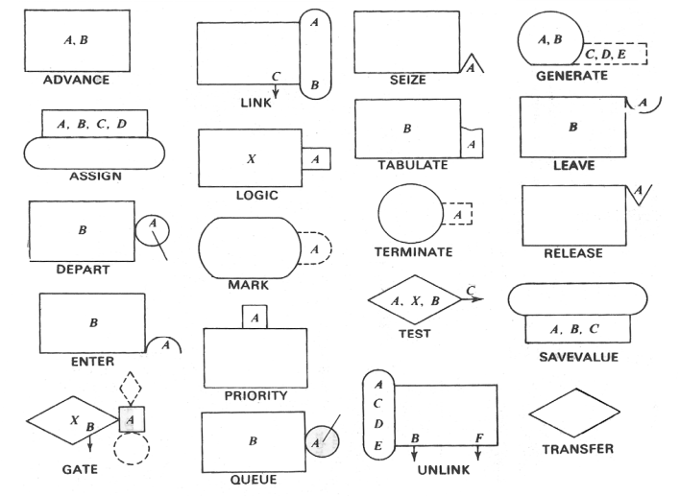
GPSS Blocks

Slide 30
Characteristics of the Blocks
Transactions
Block/Action Time
Succession of Events
Selection Factor/ Choice of path
Items of equipment
(Please refer notes for this section)

Slide 31

GPSS Blocks - GENERATE
Create transaction and place on future event chain for the simulation.
Eg: GENERATE A, B, C, D, E, F, G, H, I
A is Mean inter-arrival time
B is modifier of the mean (optional)
C is delay-time or offset (optional)
D is creation limit (optional)
E is priority-level (optional)
F through I specify the number of parameters
GENERATE 0.1 means a transaction enter the simulation every tenth of a time unit.

Slide 32
GPSS Blocks - GENERATE
GENERATE 4
An entity is generated every 4 time-unit.
Since no B argument is present, generation will occur at precisely 4 time-unit intervals.
The lack of a C variable implies this generation process will begin at time 0 .
Since no D argument is present, this statement will continue generating entities until the simulation is concluded.

Slide 33
GPSS Blocks - GENERATE
GENERATE 4, 3
Entities Are generated every 4 ± 3 time-units. The generation times will be distributed uniformly from 1 to 7 time-units.
GENERATE 4, 3, 2
Entities are generated at intervals of 1 to 7 time-units uniformly distributed, beginning at time 2 for the duration of the simulation.
GENERATE 4, 3, 2, 5
A total of 5 entities are generated at intervals 1 to 7 time-units uniformly distributed beginning at time 2.
GENERATE , , 2, 5
Five entities are generated at time 2.

Slide 34

GPSS Blocks - TERMINATE
Removes transaction from the simulation and reduces the termination count.
Eg: TERMINATE A
Termination count decrement. Default is 0.
TERMINATE 1 means the transaction is removed from the simulation and the termination count of the simulation which is set by a START command is decremented by 1.
TERMINATE 0 means the entity is removed but the START is not decremented.

Slide 35

GPSS Blocks - ADVANCE
ADVANCE block delays the progress of a transaction form a specified amount of simulated time.
The program computes an interval of time called an action time for each transaction as it enters an ‘ADVANCE’ blocks and transaction remain at this block up to that action time.
Eg: ADVANCE A, B
A is mean time and B is modifier of the mean (optional)

Slide 36
Storage and Facilities
Item of equipment can be classified into storage and facilities, depending upon the capacity for handling the transactions.
An item of equipment, which can handle only one transaction at a time, is called a facility while the items of equipment, which can handle a large number of transactions at the same time is called storage.
Example: In communication system, message is transaction, switch(pass only one message) is facility while trunk(collection of wire carrying several messages simultaneously) is storage.

Slide 37


Storage and Facilities
In SEIZE, RELEASE, ENTER, LEAVE blocks, field ‘A’ indicates which facility or storage is intended
SEIZE block allows the transaction to engage a facility if it is available
RELEASE block allows the transaction to disengage the facility
Eg: SEIZE A
RELEASE A
A can be a number or a symbolic name for the facility.

Slide 38
Storage and Facilities
Facility or Storage may be reference by either a number or a symbolic name. Following two GPSS statements cause a facility (server) named TELLER (representing a bank teller) to become busy and then idle.
SEIZE TELLER RELEASE TELLER
One of the key pieces of information that can be obtained from GPSS simulation is the average utilization of the facilities. This statistic is computed automatically by GPSS and included in the standard output .

Slide 39
Control Cards
To execute even a minimal GPSS program, several control cards (statements) are required such as SIMULATE, START, END, etc.
The SIMULATE control card must appear if a GPSS model is to be executed. If SIMULATE is not used the program is translated and checked for syntax errors and then immediately terminated and thus you cannot view the output results.

Slide 40
Control Cards
The START control card signifies the end of a model description and then initiates the execution of the model, if a SIMULATE statement is present.
Eg: START A, B, C
A is termination counter which is decremented when transaction enters the TERMINATE block with nonzero value.
Simulation stops when the value of the counter is less than or equal to zero.
B is the statistics to print out at the end of simulation run for reports
C is not used and kept for compatibility with older dialects of GPSS

Slide 41
Control Cards
START 250
The GPSS statement is simulated until the start count which is initially set to 250 reaches to 0.
START 10, NP
The model is simulated until the start count reaches 0 from an initial value of 10. No statistics are printed.

Slide 42
Control Cards
In many situations, it is desirable to execute a simulation program and then make a minor changes to the program and execute the program again. GPSS provides two control statements for repeating execution
RESET is used to restart the execution of a model while retaining all entities in queues facilities and storages .
CLEAR restarts the computation of all statistics.

Slide 43
Entities
Transaction entities:
GENERATE, SPLIT, TRANSFER, TERMINATE
Facilities entities:
SEIZE, RELEASE
Queue entities:
QUEUE, DEPART
Storage entities:
ENTER, LEAVE
Gathering Statistics
QUEUE, DEPART, MARK, TABULATE

Slide 44
GPSS Simulation Example 1
We are assuming the following set of parameters to write a GPSS simulation program for drive thru model of a restaurant.
Customer arrival rate, from 3 to 5 minutes.
Time required to drive from main entrance to drive thru window (facility ) = 1 minute
Order processing rate - from 1 to 7 minutes per customer uniformly distributed.
Length of simulation (simulation termination) 250 customers.
Based upon these parameters, we can equate one GPSS time unit with one minute of simulation time.

Slide 45
GPSS Simulation Solution 1
SIMULATE Begin simulation
GENERATE 4, 1 Customer arrival rate 3 to 5 min.
ADVANCE 1 Customer drive to window = 1 min.
SEIZE WINDO Customer reaches at window.
ADVANCE 4, 3 Customer order is processed (1 to 7 min).
RELEASE WINDO Customer departs from windows after service.
TERMINATE 1 Remove customer from the system
* Termination condition
START 250 Process 250 customers.

Slide 46


QUEUE and DEPART
GPSS contains features that provide extensive queueing statistics.
The bookkeeping mechanism for a queue is activated whenever an entity executes a QUEUE statement.
The departure of an entity from a queue is indicated by execution of DEPART statement .
Eg: QUEUE A, B
DEPART A, B
A is the queue name
B is the number of entities entering or departing the queue.

Slide 47
QUEUE and DEPART
If queuing statistics for the facility TELLER are desired, the following sequence should appear in the program.
QUEUE WINDO
SEIZE TELLER DEPART WINDO
or
QUEUE 1
SEIZE TELLER
DEPART 1

Slide 48
GPSS Simulation Example 2
We are assuming the following set of parameters to write a GPSS simulation program for drive-in-window model.
Customer arrival rate, from 1 to 3 minutes.
Time required to drive from main entrance to drive-in-window (QUEUE) = 1 minute
Teller processing rate - from 1 to 5 minutes per customer
Length of simulation (simulation termination) 250 customers.
Based upon these parameters, we can equate one GPSS time unit with one minute of simulation time.

Slide 49
GPSS Simulation Solution 2
SIMULATE
GENERATE 2, 1
ADVANCE 1
QUEUE WINDO
SEIZE TELLER
DEPART WINDO
ADVANCE 3, 2
RELEASE TELLER
TERMINATE 1
START 250

Slide 50

GPSS Blocks - TRANSFER
A, B, C
The ‘TRANSFER’ block allows some location other than the next sequential location to be selected i.e. when there is choice of activities, we use this block by stating the condition for the choice.
The choice is normally between 2 blocks refer to as next block ‘A’ and ‘B’.
Eg: TRANSFER A, B, C
A is selection factor, B and C blocks are exit1 and exit2 respectively.
TRANSFER 0.1, ACC, REJ means 10% go to location REJ(exit2) and 90% to ACC(exit1).

Slide 51
GPSS Simulation Example 3
In a manufacturing shop, a machine tools turns out parts at the rate of one every five minutes.
As they are finished the posts go to inspector, who takes 4±3 minutes to examine each part and rejects 10% of parts.
Each part will be represented by one transaction and time unit selected for problem will be one minute.
Simulate for 1000 parts to leave the system. Generate GPSS block diagram and code for the above system.

Slide 52
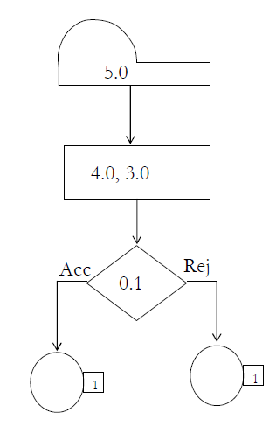
GPSS Simulation Solution 3
SIMULATE
GENERATE 5
ADVANCE 4, 3
TRANSFER 0.1, ACC, REJ
ACC TERMINATE 1
REJ TERMINATE 1
START 1000

Slide 53
GPSS Simulation Example 4
In a manufacturing shop, a machine tools turns out parts at the rate of one every five minutes.
As they are finished the posts go to inspector, who takes 4±3 minutes to examine each part and rejects 10% of parts.
Each part will be represented by one transaction and time unit selected for problem will be one minute.
Simulate for 1000 parts to leave the system assuimg that there is only one inspector.

Slide 54
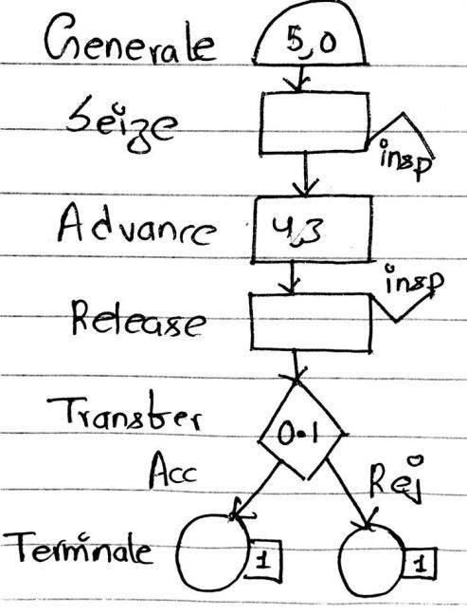
GPSS Simulation Solution 4
SIMULATE
GENERATE 5
SEIZE insp
ADVANCE 4, 3
RELEASE insp
TRANSFER 0.1, ACC, REJ
ACC TERMINATE 1
REJ TERMINATE 1
START 1000

Slide 55
STORAGE
To describe an activity involving multiple entities, a storage is used.
The size of storage may be varied using a RESET or CLEAR control bars.
Unlike facilities, storage must be explicitly defined. The format of STORAGE statement is as
LABEL STORAGE A
LABEL is the name of the storage
A is the size of the storage

Slide 56
STORAGE
The statements permitting entities to enter and leave stories are ENTER and LEAVE respectively. Their formats are as follows:
ENTER A, B
LEAVE A, B
A is the storage name
B is the number of units of storage to be occupied or released. Default 1.

Slide 57
STORAGE
When an entity attempts to enter the storage, it requests the number of storage units specified in the B argument of ENTER statement. If insufficient unit of storage are available, the entity is blocked until a sufficient number of units are free.
When an entity leaves a storage, the number of units indicated by the B argument of the LEAVE statement are freed.

Slide 58
STORAGE
Eg:
SEATS STORAGE 100
A storage name SEATS of size 100 is defined.
ENTER SEATS
If there is available storage, an entity occupies 1 unit in the storage.
LEAVE SEATS
An entity leaves the storage SEATS freeing 1 unit.

Slide 59
GPSS Simulation Example 5
In a manufacturing shop, a machine tools turns out parts at the rate of one every five minutes.
As they are finished the posts go to inspector, who takes 4±3 minutes to examine each part and rejects 10% of parts.
Each part will be represented by one transaction and time unit selected for problem will be one minute.
Simulate for 1000 parts to leave the system assuming that there are three inspectors.

Slide 60
GPSS Simulation Solution 5
SIMULATE
GENERATE 5
ENTER insp
ADVANCE 4, 3
LEAVE insp
TRANSFER 0.1, ACC, REJ
ACC TERMINATE 1
REJ TERMINATE 1
insp STORAGE 3
START 1000

Slide 61
GPSS Simulation Example 6
Consider a factory that manufactures football taking 20 to 40 minutes. The ball is moved from the generation to the inspection machine taking a 2 minutes.
There are 3 inspection machine at one place and need 30 to 60 minutes for inspection and reject 30% of football. Simulate for 1000 transaction Draw GPSS block diagram to simulate this system.

Slide 62
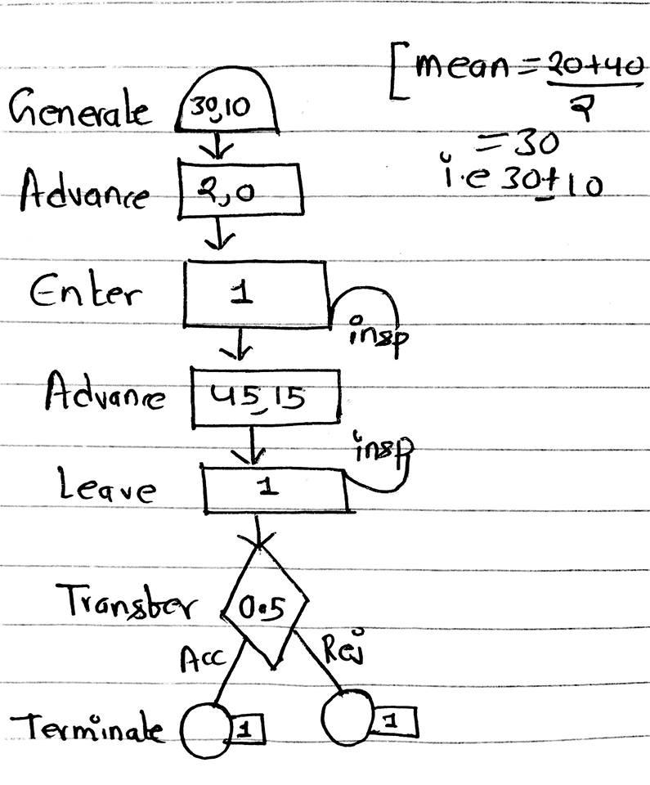
GPSS Simulation Solution 6
GENERATE 30, 10
ADVANCE 2, 0
ENTER insp
ADVANCE 45, 15
LEAVE insp
TRANSFER 0.5, ACC, REJ
ACC TERMINATE 1
REJ TERMINATE 1
insp STORAGE 3
START 1000

Slide 63
GPSS Simulation Example 7
Simulate one day of operation of a barber shop for 200 customers.
Customers arrive in a barber shop at the rate of 18±6 minutes , enter the shop, queue if the barber is busy, get their hair cut which take 16±4 minutes on a firstcome first-served basis, and then leave the shop.

Slide 64
GPSS Simulation Solution 7
SIMULATE
GENERATE 18, 6 Customer arrive every 18±6 m
QUEUE Chairs Enter the line
SEIZE Hari Capture the barber
DEPART Chairs Away from the line
ADVANCE 16, 4 Get a hair cut in 16±4 mn
RELEASE Hari Free the barber
TERMINATE 1 Leave the shop
START 200

Slide 65
GPSS Simulation Example 8
Workers come to a supply at the rate of 1 every 5 ± 2 minutes. Their requisitions are processed by two clerks who take 8 ± 4 minutes for each requisition. The requisition are then passed to a single storekeeper who fills them one at a time taking 4 ± 3 minutes for each request. Simulate queue of workers and measure the distribution of time taken for 1000 requisitions to be filled. Generated GPSS code for above statement

Slide 66
GPSS Simulation Solution 8
SIMULATE
* Generate entities and parameters
GENERATE 5, 2 Workers arrival
QUEUE ClerkQ Queue for clerks
ENTER ClerkStorage, 1 Workers enter clerk storage
DEPART ClerkQ Leave the clerk queue
ADVANCE 8, 4 Clerk takes time to process requisitions
LEAVE ClerkStorage, 1 Workers leave clerk storage

Slide 67
GPSS Simulation Solution 8
* Pass to store keeper
QUEUE StoreKeeperQ Queue for storekeeper
SEIZE StoreKeeper Storekeeper processes requisition
DEPART StoreKeeperQ Leave the storekeeper queue
ADVANCE 4, 3 Storekeeper takes time to fill requisitions
RELEASE StoreKeeper Release the storekeeper
TERMINATE 1
STORAGE ClerkStorage, 2 2 clerks are represented by storage
FACILITY Stoerkeeper
END

Slide 68


Gathering Statistics
Block types such as QUEUE, DEPART, MARK and TABULATE are used to gather statistic about the system performance but not to represent the system action.
When the condition for advancing a transaction is not satisfied several transactions may be kept waiting at a block and due to this the QUEUE block increase and DEPART block decreases the number in field A
i.e. queue block increases the queue number while depart block decreases the queue number. A is queue number, B is the quantity by which the queue number is being increased

Slide 69
Gathering Statistics
The MARK and TABULATE blocks are used to measure the length of time taken by transaction to move the system or parts of the system.
The MARK block simply notes the arrival time on the transaction and the TABULATE blocks subtracts the time noted by MARKED block from the time of arrival at the TABULATE block.

Slide 70
Condition Transfer
Refer the notes for this topic.

Slide 71
End of Lecture 18

Slide 72
SIMSCRIPT

